Slide 1
Introduction to:
Linear Mixed Effects models

Slide 2
Linear mixed models
Multilevel models
Hierarchical linear models

Slide 3
Linear mixed models
Multilevel models
Hierarchical linear models
$Y$
$β_{1}$
$β_{0}$
$X$

Slide 4
Linear mixed models
Multilevel models
Hierarchical linear models
$Y=β_{0}+β_{1}X$

Slide 5
Linear mixed models
Multilevel models
Hierarchical linear models
It is a linear model because the parameters combine additively;
it is the model that needs to
be linear, not necessarily
the relationship(s)
$Y={ae}^{βx}$
ln

Slide 7
Linear mixed models
Multilevel models
Hierarchical linear models
$Y=β_{0}+β_{1}X$
Fixed effects: we assume that the model holds true across the entire sample and that for every
case of data in the sample we can predict a score using the same values of the
slope and intercept.
$Y$
$β_{1}$
Random effects: we say that a parameter is random then we assume not that it is a
fixed value, but that its value can vary.
$β_{0}$
$X$

Slide 8
Random Intercepts
Category 1
Category 2
Category 3
$Acc$
(i.e., differences in “overall” performance)
$PE$

Slide 9
Random Slopes
Category 1
Category 2
Category 3
$Acc$
(i.e., differences in the effect across categories)
$PE$

Slide 10
Random Intercepts and Slopes
Category 1
Category 2
Category 3
$Acc$
(i.e., differences in the size of the effect across conditions)
Including random intercepts and slopes allows to control for random variations among items (sampling units)
$PE$

Slide 11
Linear mixed models
Multilevel models
Hierarchical linear models
Nested data

Slide 12
Linear mixed models
Multilevel models
Hierarchical linear models
Nested data
Taking into account within- and between-person variability

Slide 13
ID 4
ID 3
Between-participant level:
Participants with higher PE on average performed better
ID 2
$Acc$
ID 1
$PE$

Slide 14
ID 4
ID 3
ID 2
Within-participant level:
When participants experienced higher PE their performance decreased
ID 1
$Acc$
$PE$

Slide 15
ID 4
ID 3
ID 2
ID 1
$Acc$
$PE$
“The reason for favoring the within-subject level is that omitted and confounding variables are less likely to be a problem when analyses focus on how and why people change over time than on how people differ from one another”.
(Bolger & Laurenceau, Intensive longitudinal methods: An introduction to diary and experience sampling research, 2013).

Slide 16
Random Intercepts and Slopes
Participant 1
Participant 2
Participant 3
Fixed effect (Intercept and slope for the average person)
$Acc$
$PE$

Slide 17
Level 1 (within-subjects)– dependent variable Y at time point i for a particular subject j.
_{ij}
is a within-subject residual term representing the difference, at a given time point between the predicted Y for a given subject and the actual value.
_{0j}
Level 2 (between-subjects)
_{1j}
Subject 1
) +( ₁₁) + _{i1}
$γ\text{1}\text{0}$
Typical person
$γ\text{00}$
$Y_{ij}=γ\text{00}+γ\text{1}\text{0}X_{ij}$
Subject 2
X
) +( ₁₂) + _{i2}
_{0j}
_{1j}

Slide 18
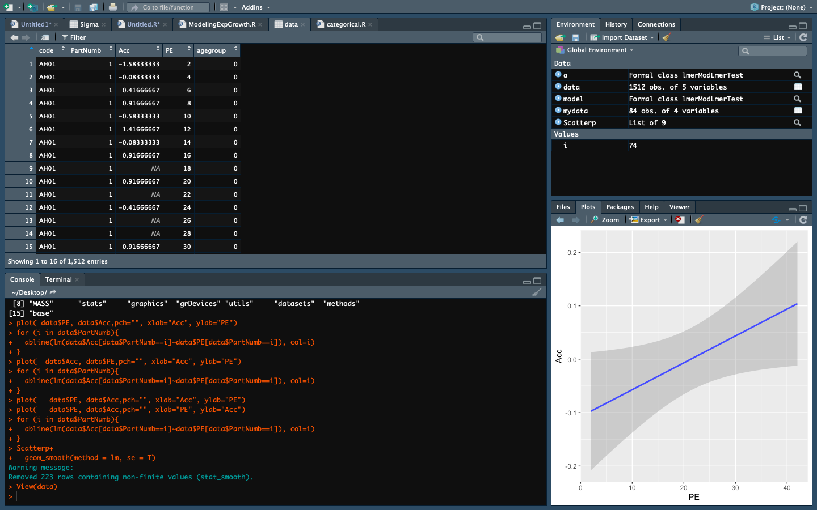

Slide 19
Library(”ggplot2”)

Slide 20
LM<-lm(Acc~PE,data=data)

Slide 21
Library(”lme4”) MLM<-lmer(Acc~PE+(PE|PartNumb), data=data)
Random effects:
Groups Name Variance Std.Dev. Corr
PartNumb (Intercept) 0.3662782 0.60521
PE 0.0008159 0.02856 -1.00
Residual 1.2540770 1.11986
Number of obs: 627, groups: PartNumb, 38
Fixed effects:
Estimate Std. Error df t value Pr(>|t|)
(Intercept) -0.232759 0.133371 41.963984 -1.745 0.0883 .
PE 1 0.011369 0.006011 40.291277 1.891 0.0658 .
---
Signif. codes: 0 ‘***’ 0.001 ‘**’ 0.01 ‘*’ 0.05 ‘.’ 0.1 ‘ ’ 1

Slide 22
To sum up, benefits of using LMM:
Control for random variability between items
Focus on within-participants processes
Separate within-participant from between-participant variability
Account for dependency in the data
Allow to deal with missing data

Slide 23
Thank you!

